Slide 1
ICEsat-2 higher-level elevation products
Ben Smith, and the ICEsat-2 land-ice team

Slide 2
ATL11 and surface-height corrections
ATL06
h
ATL11 gives h(t) for a given point covered by repeat tracks
Uses consistency checks to cull blunders from the ATL06 record
Computes a local-topography correction to remove height variations due to small-scale surface slopes
Gives values that can be directly differenced to give dh/dt
The product should be regenerated at the end of each mission year
Regenerating the product improves the estimate of the reference surface
Each generation will use all data available to date
y
ATL11
h_{ref}
y
h₀
t

Slide 3
ATL11 data scheme
4 repeats/yr
lat₁ | lon₁ | time₁₁ | z₁₁ | time₁₂ | z₁₂ | time₁₃ | z₁₃ | time₁₄ | z₁₄ | time₁₅ | z₁₅
lat₂ | lon₂ | time₂₁ | z₂₁ | time₂₂ | z₂₂ | time₂₃ | z₂₃ | time₁₄ | z₂₄ | time₂₅ | z₂₅
lat₃ | lon₃ | time₃₁ | z₃₁ | time₃₂ | z₃₂ | time₃₃ | z₃₃ | time₃₄ | z₃₄ | time₃₅ | z₃₅
z_{1N}
z_{2N}
z_{3N}
…
1 reference pt/ 60 m
…
…
lat_{M} | lon_{M} | time_{M1} | z_{M1} | time_{M2} | z_{M2} | time_{M3} | z_{M3} | time_{M4} | z_{M4} | time_{M5} | z_{M5}
…
z_{3N}

Slide 4
ATL11 flow chart
Are the x and y slopes consistent?
Do both beams have high signal quality?
Are both beams close to the reference point?
Reference surface fit
ATL06 data
Selected pairs
H(t) for selected repeats
H(t) for unselected repeats
Select seg. with min. error per epoch
Unselected segments
Reference surface at segments
Crossover ATL06
H(t) for crossing tracks

Slide 5
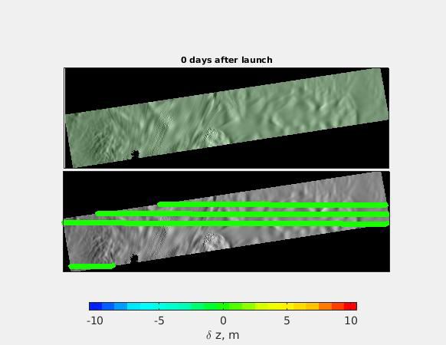
ATL11 simulated data
Seed: PIG DEM plus a 30-km-wavelength sinusoid that grows in year 2
Clouds simulated based on statistics of ICESat-1 cloud-thickness estimates

Slide 6
ATL11 correction schematic
ICESat-2 data formats talk
ATL11: in 3D
14/20

Slide 7
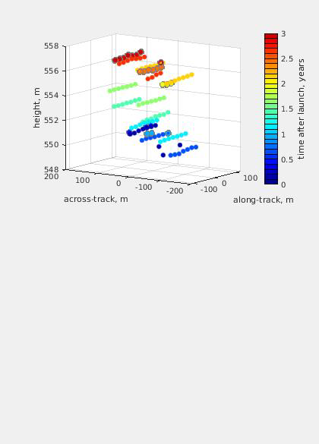
ATL11 correction schematic

Slide 8
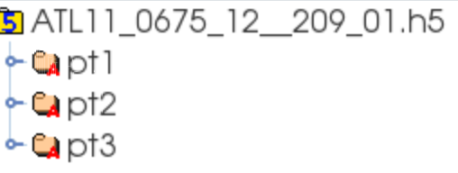
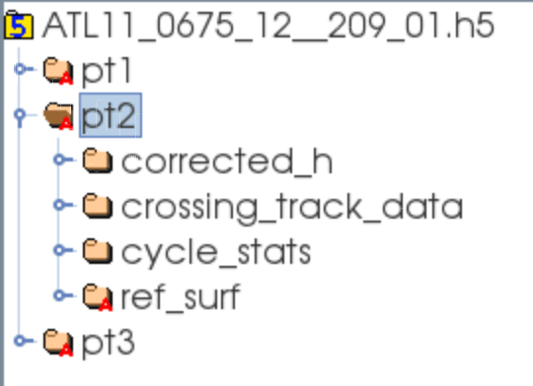
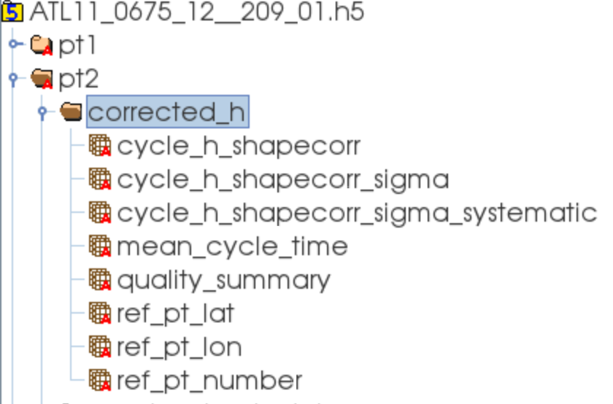
ATL11 structure:
One group per pair track
Corrected_h: latitude, longitude, h, time, and errors
Crossing-track data: data from crossing tracks
Cycle_stats: summary statistics of parameters for each cycle
Ref_surf: the location and shape of the reference surface
Corrected_h is intended to carry the most important parameters (lat, lon, time, and elevation for each cycle)

Slide 9
ATL14 and 15: Digital elevation models and elevation change
ATL14 provides:
DEM, posted at 125 m
ATL15 provides:
ICESat-1 – ICESat-2 elevation difference map, posted at 1 km
ATL14 elevation change surfaces, posted at 500 m / 3 mo.
Least-squares-surface fitting algorithm combines ATL11 elevations to fill in gaps between tracks and missing repeats
Both products will be regenerated each year, starting late 2019 / early 2020
z(t, x, y) = z₀(x,y) + δz(t, x, y)
ATL11
Height corrected for small-scale topography
ATL14
DEM
ATL15
Height-change maps

Slide 10
Status as of June, 2019
We can’t generate along-track differences for ATL11 now (don’t have repeat data)
Current ATL11 prototypes include:
Reference elevations defined from one reference cycle (cycle 1 or cycle 2)
Crossover elevations from both cycles
For gridded elevation-change testing, I have experimented with ICESat-1-ICESat-2 differences

Slide 11
Elevation-differencing scheme for ICEsat-1-ICEsat-2 differences
Given z(x, y, t, M), solve for:
z₀(x,y)
dz/dt(x, y)
B(M, t)
that minimizes:
r : data-model misfit
C_{d}: Expected data errors
m: DEM, elevation-change rate, data biases
F : Complexity of the model
C_{r}: Expected complexity of the model
Direct linear solutions are moderately difficult for 100x100 km areas:
Solve for z0 at 250 m
Solve for dz/dt at 2 km

Slide 12
How does this work with IS1-IS2 data?
Choose z₀ to be the surface height in 2020
Operate on large (100-km x 100-km) tiles
Overlap tiles by 50%
Use the REMA DEM to reject outliers from both datasets
tolerance = 3 max(1m, σ_{mission})
Iterate fitting and editing to reduce outliers
After 6 iterations on each tile, form a consensus set of edited data between adjacent tiles, and run a final iteration to remove scene-to-scene boundaries

Slide 13
Iteration 1
Iteration 2
Difference

Slide 15
